Slide 1
Data Exploration with MongoDB and SQL
Prepared For: CS527
Prepared By: Josh Levine, Pranav Shivkumar, Pratik Mistry, Shounak Rangwala, Swapnil Kamate, Vikhyat Dhamija

Slide 2
The Data
Our data set included a small csv file called challenger with 3 columns.
O-Ring Failure: Y/N
Launch Temperature: Integer
Leak-Check pressure: High/Medium/Low
Our tasks our to load the csv file into a MongoDB/SQL server and write java scripts/SQL stored procedures for various aggregate functions respectively to perform univariate and bivariate analysis on the data

Slide 3
MongoDB + Java DEMO

Slide 4
Task 1: Count and Count%: Categorical Univariate Analysis
Count: returns a count of each category within one categorical attribute.
Count%: returns the percentage of each category within one categorical attribute.
Leak-check pressure
High
High
Medium
Low
Example
Count
High: 2
Medium: 1
Low: 1
Count%
High: 50%
Medium: 25%
Low: 25%

Slide 5
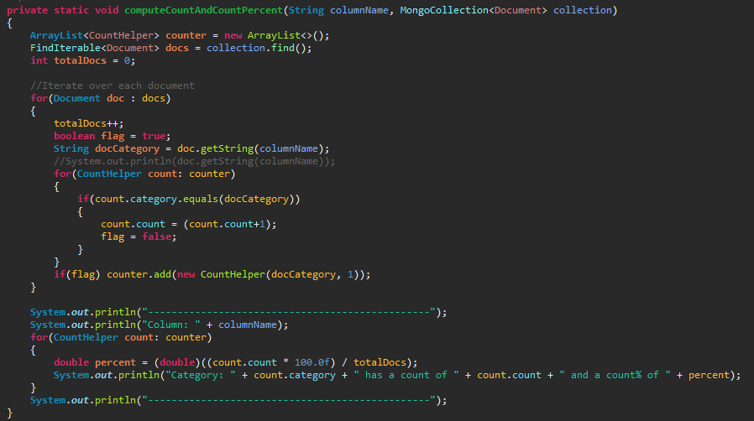
Task 1: Count and Count% Demo (Java+MongoDB)

Slide 6

Task 1: (Java+MongoDB) Output

Slide 7

Task 2: Min, Max, Range, Mean, Mode, Median, Variance, Standard Deviation and Coefficient of Variation
Numeric Univariate Analysis.
Min: The smallest value of a data set.
Max: The largest value of a data set.
Range: The difference between the upper and lower bound. (Max - Min)
Mean: The average of the data set.
Mode: The value in the data set that appears the most.
Median: Sort the data in order, the median is the data point in the middle.

Slide 8



Task 2: ..Continued
Variance: How much a data point varies from its expected value.
Standard Deviation: A measure of how spread out the data points are
Coefficient of Variation: Ratio of the standard deviation to the mean.
(X is the average)

Slide 9
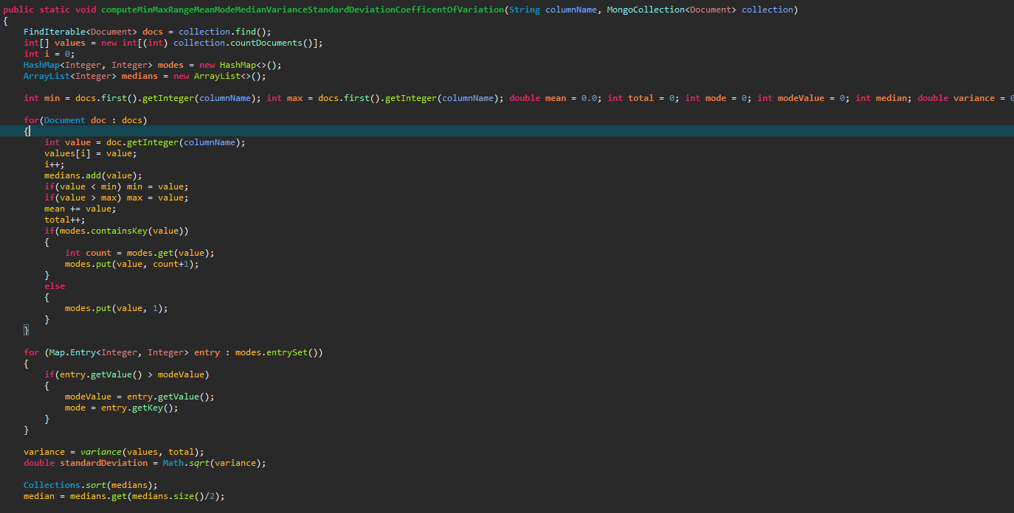
Task 2: Demo (Java + MongoDB)

Slide 10
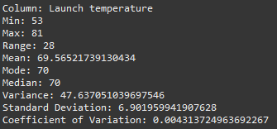
Task 2: Output (Java + MongoDB)

Slide 11
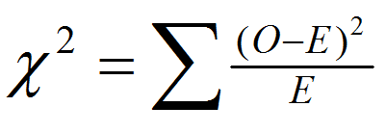
Task 3: Compute Chi2 - Categorical Bivariate Analysis
Compute the Chi2 value of two categorical attributes.
Determines if there is a statistical difference between the expected data and the observed data
Where O = Observed value, E = expected value

Slide 12
Task 3: ...Continued
Because the challenger data set does not have expected values, we need to come up with expected values by binning the data.
We will bin the data by Leak-check pressure category High. We will take the average of the temperature and use that as our expected value and we will use each value in the Launch Temperature as the observed value.
Averaging the temperature in the High category gives us ~70

Slide 13
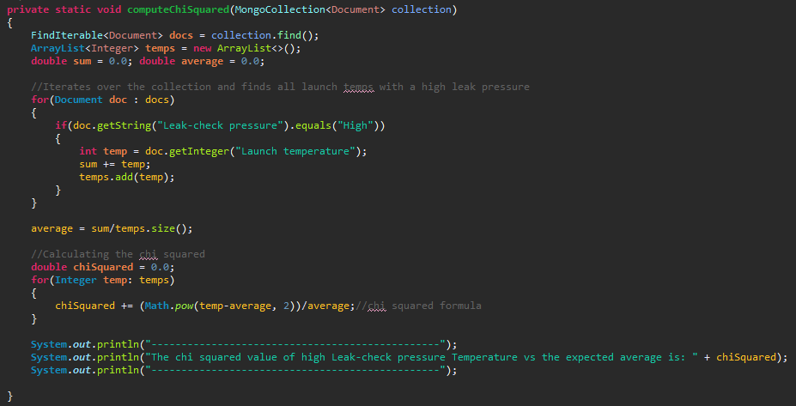
Task 3: Demo (Java + MongoDB)

Slide 14
Task 3: Output (Java + MongoDB)
Our Results do not mean much because they serve as input for the p-value.
P-Value: the probability of obtaining results as extreme as the observed results of our statistical hypothesis.

Slide 15
Task 4: Numeric Bivariate Analysis: Compute Linear Correlation
Compute the linear Correlation of two numerical attributes.
Linear correlation is a measure of dependence between two random variables.
Types of Correlations:
Positive: both variables change in the same direction
Neutral: No relationship in the variables.
Negative: both variables change in the opposite direction

Slide 16
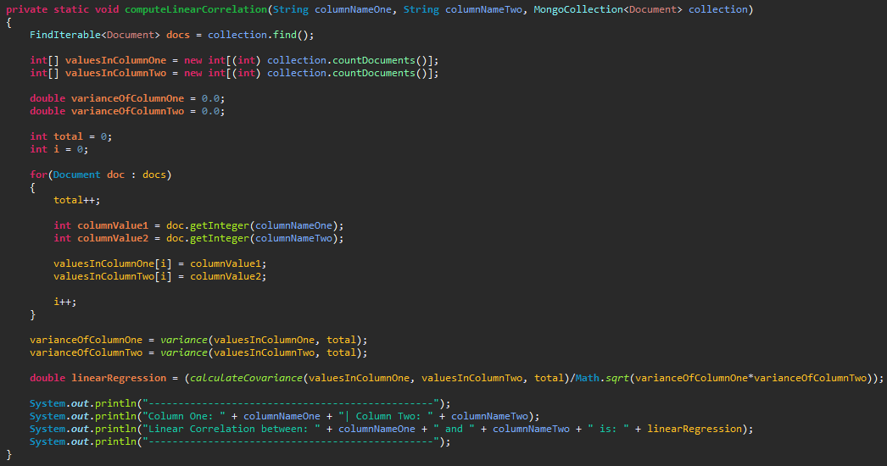
Task 4: (Java + MongoDB) Demo

Slide 17
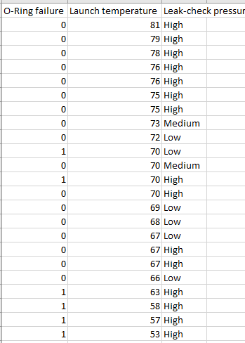
Task 4: (Java + MongoDB) Output
Note: A negative correlation means that there is an inverse relationship between O-Ring Failure and Launch Temperature columns.
Which can be observed when you sort the data by Launch Temperature.

Slide 18
Task 5: Categorical and Numeric Bivariate Analysis: Compute Z Value
Compute the Z Value of one numerical and one categorical attribute.
Z-score describes the values difference from the mean.
Positive means it lies above the mean.
Negative means it lies below the mean.
Z-Score is important because it helps standardize values
Allows for researchers to calculate the probability of a score occuring within a standard normal distribution.
Allows us to to compare two scores that are from different samples.

Slide 19
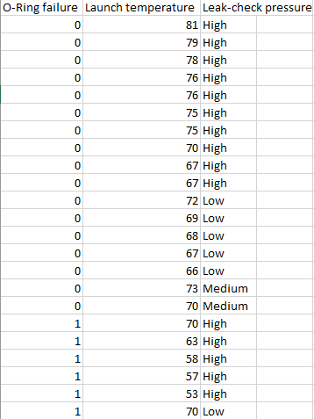
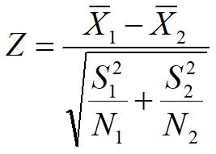
Task 5: Compute Z Value
Categorical: O-Ring Failure
Numerical: Launch Temperature
Our two lists of variables to compare will be all Launch temperatures with an O-Ring failure of 0 vs all Launch temperatures with an O-Ring failure of 1
Where S = variance,
N = counts

Slide 20
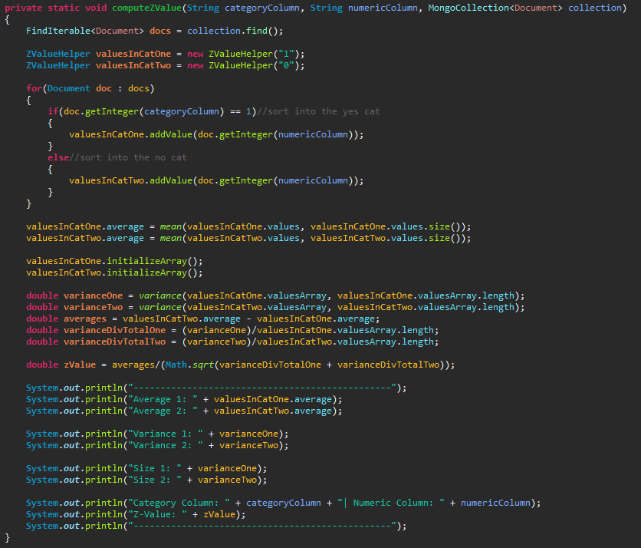
Task 5: (Java + MongoDB) Demo

Slide 21
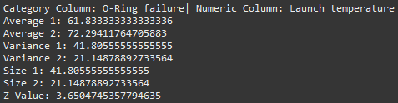
Task 5: (Java + MongoDB) Output
We are deviating about 3.65 from the mean.

Slide 22
RDBMS: SQL DEMO

Slide 23
Task 1: Count and Count% Demo (SQL SP’s)
CREATE procedure [dbo].[task1]
as
declare @total_count float
set @total_count=(select count(Leak_check_pressure) from Challenger)
select Leak_check_pressure , count() as Count ,(count()*100/@total_count) as Count_percent from challenger group by Leak_check_pressure
Go

Slide 24

Task 1: Count and Count% Output (SQL SP’s)

Slide 25
Task 2: Demo (SQL SP)
Create procedure [dbo].[task2] as
declare @mean_temp float,@max_temp float,@min_temp float,@mode_temp float, @median_temp float, @range_temp float, @variance_temp float, @std_dev float, @count_temp float, @cov float
set @count_temp=(select count(*) from Challenger)
set @mean_temp=(select avg(Launch_temperature) from Challenger)
set @max_temp=(select max(Launch_temperature) from Challenger)
set @min_temp=(select min(Launch_temperature) from Challenger)
set @mode_temp=(select top 1 Launch_temperature from challenger group by Launch_temperature order by count(*) desc)
set @median_temp=(select Launch_temperature as Median from (SELECT Launch_temperature , ROW_NUMBER () OVER (ORDER BY Launch_temperature) As rows FROM challenger) as temp WHERE temp.rows = 12)
set @range_temp=@max_temp-@min_temp
set @variance_temp=(select sum(square(Launch_temperature- @mean_temp))/@count_temp from challenger)
set @std_dev=SQRT(@variance_temp)
set @cov=(@std_dev*100/@mean_temp)
select @min_temp as Minimum , @max_temp as Maximum , @range_temp as Range , @mean_temp as Mean , @median_temp as Median , @mode_temp as Mode , @variance_temp as Variance , @std_dev as Std_dev , @cov as COV
go

Slide 26
Task 2: Output (SQL SP)

Slide 27

Task 3: Pivot Table
Below is the pivot table for two categorical columns on which we will perform Chi 2 Test:

Slide 28
Task 3: Demo (SQL SP)
CREATE procedure [dbo].[task3]
as
declare @total_low float,@total_high float,@total_medium float, @total_one float, @total_zero float, @total float, @zero_low float, @zero_high float, @zero_medium float, @one_low float, @one_high float, @one_medium float, @exp_zero_low float, @exp_zero_high float, @exp_zero_medium float, @exp_one_low float, @exp_one_high float, @exp_one_medium float, @chi_sq float, @cont_coeff float
set @total_low=(select sum([Low]) from chi_pivot)
set @total_high=(select sum([High]) from chi_pivot)
set @total_medium=(select sum([Medium]) from chi_pivot)
set @total_zero=(select sum([Low])+sum([High])+sum([Medium]) from chi_pivot where O_ring_failure=0)
set @total_one=(select sum([Low])+sum([High])+sum([Medium]) from chi_pivot where O_ring_failure=1)
set @total=@total_zero+@total_one
set @zero_low=(select [Low] from chi_pivot where O_ring_failure=0)
set @zero_high=(select [High] from chi_pivot where O_ring_failure=0)
set @zero_medium=(select [Medium] from chi_pivot where O_ring_failure=0)\
set @one_low=(select [Low] from chi_pivot where O_ring_failure=1)
set @one_high=(select [High] from chi_pivot where O_ring_failure=1)

Slide 29
Task 3: Demo (SQL SP) Continued
set @one_medium=(select [Medium] from chi_pivot where O_ring_failure=1)
set @exp_zero_low=(@total_zero*@total_low)/@total
set @exp_zero_medium=(@total_zero*@total_medium)/@total
set @exp_zero_high=(@total_zero*@total_high)/@total
set @exp_one_low=(@total_one*@total_low)/@total
set @exp_one_medium=(@total_one*@total_medium)/@total
set @exp_one_high=(@total_one*@total_high)/@total
set@chi_sq=(square(@exp_zero_low-@zero_low)/@exp_zero_low)+(square(@exp_zero_medium-@zero_medium)/@exp_zero_medium)+(square(@exp_zero_high-@zero_high)/@exp_zero_high)+(square(@exp_one_low-@one_low)/@exp_one_low)+(square(@exp_one_medium-@one_medium)/@exp_one_medium)+(square(@exp_one_high-@one_high)/@exp_one_high) set @cont_coeff=sqrt(@chi_sq/(sqrt(2)*@total))
select @chi_sq as CHI2 , @cont_coeff as Contigency_coefficient
Go

Slide 30

Task 3: Output (SQL SP)

Slide 31
Task 4: (SQL SP) Demo
Create procedure [dbo].[task4]
as
select (Avg(ConfirmedCases * Fatalities) - (Avg(ConfirmedCases) * Avg(Fatalities))) / (StDevP(ConfirmedCases) * StDevP(Fatalities)) as Linear_correlation_coeff from COVID
Go

Slide 32

Task 4: (SQL SP) Output

Slide 33
Task 5: (SQL SP ) Demo
CREATE procedure [dbo].[task5]
as
declare @mean_zero float, @mean_one float, @std_dev_one float, @std_dev_zero float
set @mean_zero=(select avg(Launch_temperature) from challenger where O_Ring_failure=0)
set @mean_one=(select avg(Launch_temperature) from challenger where O_Ring_failure=1)
set @std_dev_one=(select stdev(Launch_temperature) from challenger where O_Ring_failure=1)
set @std_dev_zero=(select stdev(Launch_temperature) from challenger where O_Ring_failure=0)
select O_Ring_failure,Launch_temperature,((Launch_temperature-@mean_zero)/@std_dev_zero) as z_score from challenger where O_Ring_failure=0
Union ALL
select O_Ring_failure,Launch_temperature,((Launch_temperature-@mean_one)/@std_dev_one) as z_score from challenger where O_Ring_failure=1
Go

Slide 34
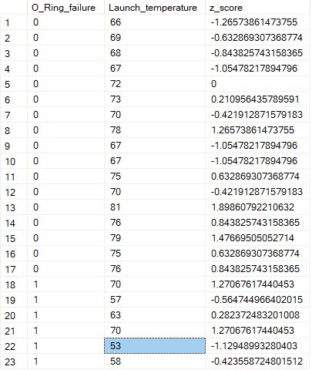
Task 5: (SQL SP) Output

Slide 35
Thank You

